Slide 1

PowerPoint Presentation Guidelines
The following 37 slides present guidelines and suggestions for the use of fonts, colors, and graphics when preparing PowerPoint presentations for Sessions and Seminars.
This media (PPT) is designed to ENHANCE your presentation, not BE the presentation.
Remember, only you can prevent
“Death by PowerPoint”

Slide 2
PowerPoint Slide
Highlight key points or reinforce what the facilitator is saying
Should be short and to the point, include only key words and phases for visual, reinforcement
In order for your presentation to fit on most screens, text and images should be placed within 95% of the PowerPoint slide. This “action safe” area is seen in the next slide.

Slide 4
PowerPoint Layout
Layout continuity from frame to frame conveys a sense of completeness
Headings, subheadings, and logos should show up in the same spot on each frame
Margins, fonts, font size, and colors should be consistent with graphics located in the same general position on each frame
Lines, boxes, borders, and open space also should be consistent throughout

Slide 5
Fonts
Font Style Should be Readable
  Recommended fonts: Arial, Tahoma,
Veranda
Standardize the Font Throughout
  This presentation is in Tahoma
Do !

Slide 6
Font Size
The larger, the better. Remember, your slides must be readable, even at the back of the room.
  This is a good title size Verdana 40 point
  A good subtitle or bullet point size Verdana 32 point
Content text should be no smaller than Verdana 24 point
This font size is not recommended for content. Verdana 12 point.
•

Slide 7
Font Size
Combining small font sizes with bold or italics is not recommended:
What does this say? Garamond Font, Italic, Bold 12pt.
This is very difficult to read. Times Font, Bold, 12pt.
Don’t !
This point could be lost. Century Gothic Font, Bold, Italic, 14pt.
No one will be able to read this. Gill Sans Font, Condensed Bold, 12pt
Small fonts are okay for a footer, such as:
TIPS Presentation: 3/8/2004
Dawn Thomas, CRM

Slide 8
Fonts
Don’t !
Don’t Sacrifice Readability for Style
DON’T SACRIFICE READABILITY FOR STYLE
Don’t Sacrifice Readability for Style
Don’t Sacrifice Readability for Style

Slide 9
Caps and Italics
DO NOT USE ALL CAPITAL LETTERS
  Makes text hard to read
  Conceals acronyms
  Denies their use for EMPHASIS
Italics
  Used for “quotes”
  Used to highlight thoughts or ideas
  Used for book, journal, or magazine titles

Slide 10
Use a Template
Use a set font and color scheme.
Different styles are disconcerting
to the audience.
You want the audience to focus on what you present, not the way you present.

Slide 11
Use the Same Background
on Each Slide
Do !!

Slide 12

Don’t use multiple backgrounds in your presentation
Changing the style is distracting
Don’t!

Slide 13
Colors
Reds and oranges are high-energy but can be difficult to stay focused on.
Greens, blues, and browns are mellower, but not as attention grabbing.
Reds and Greens can be difficult to see for those who are color blind.

Slide 14
Avoid These Combinations
Examples:
–Green on Blue
–Dark Yellow on Green
–Purple on Blue
Don’t !
–Orange on Green
–Red on Green

Slide 15
Colors
White on dark background should not be used if audience is more than 20 ft away.
  This set of slides is a good example.
  You can read the slides up close.
  The further away you get, the harder it is to read.
  This is a good color combination if viewed on a computer.
  A dark background on a computer screen reduces glare.

Slide 16
Colors
Large Hall Events
Don’t
–Avoid White Backgrounds
–The white screen can be blinding
in a dark room
–Dark Slides with Light Colored Text Work Best

Slide 17
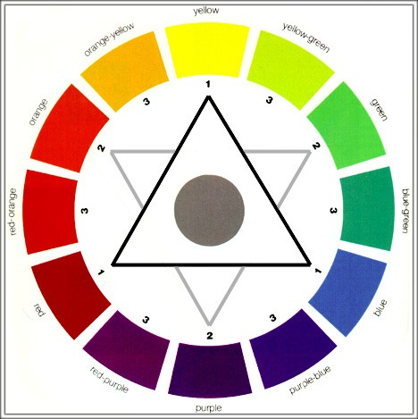
The Color Wheel
Colors separated by another color are contrasting colors (complementary)
Adjacent colors harmonize with one another (Green and Yellow)
Colors directly opposite one another are said to CLASH
Clashing colors provide
readability
– Orange on Blue
Do !

Slide 18
Background Colors
Remember: Readability! Readability! Readability!
This is a good mix of colors. Readable!
This is a bad mix of colors. Low contrast. Unreadable!
This is a good mix of colors. Readable!
This is a bad mix of colors. Avoid bright colors on white.
Unreadable!

Slide 19
Graphs and Charts
Make sure the audience can read them!

Slide 20
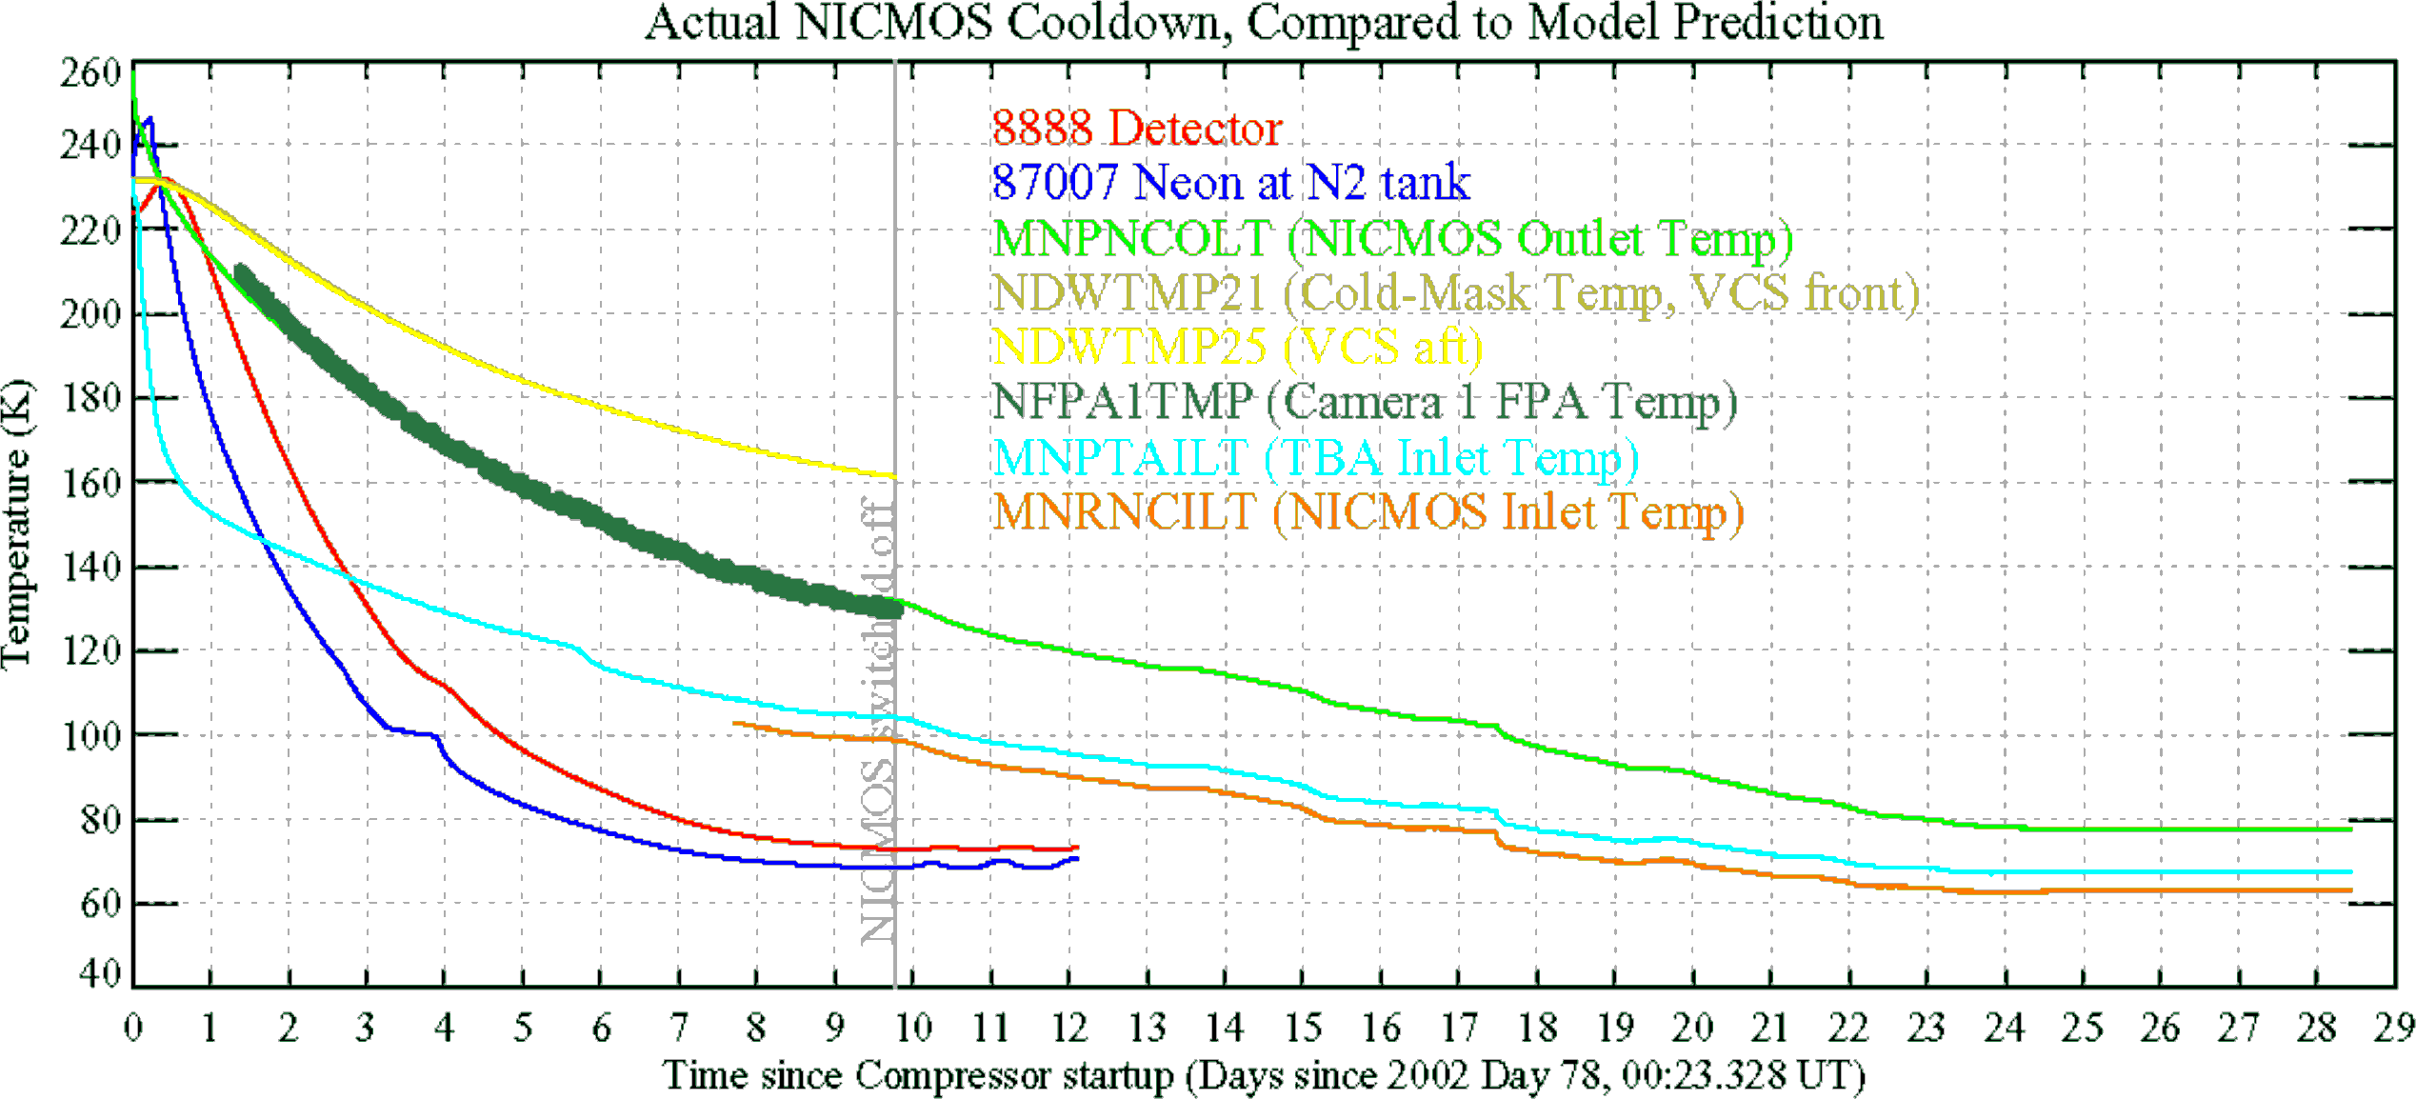
Graphics and Charts
Avoid using graphics that are difficult to read. In this example, the bright colors on a white background and the small font make the graph hard to read. It would be very difficult to see, especially in the back of a room.
Don’t !

Slide 21
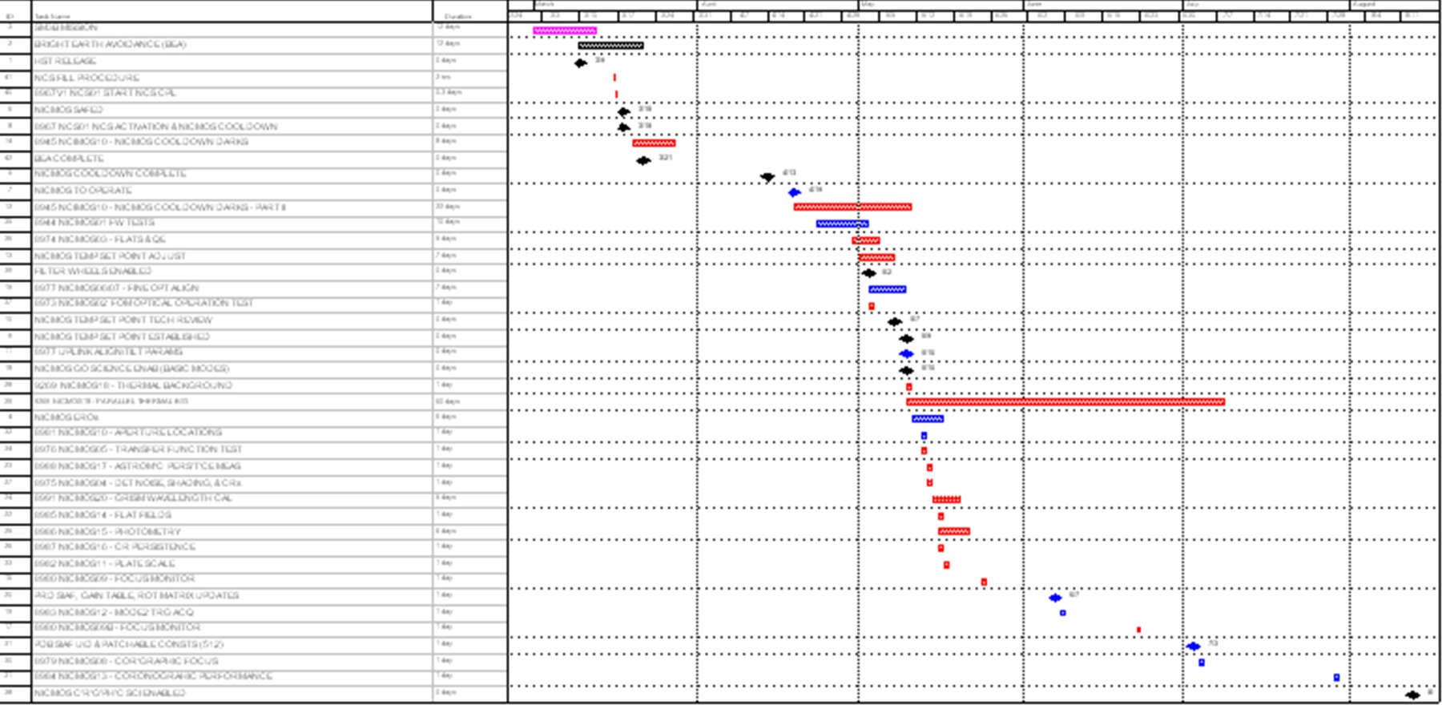
This graph contains too much information in an unreadable format.
Don’t !

Slide 22
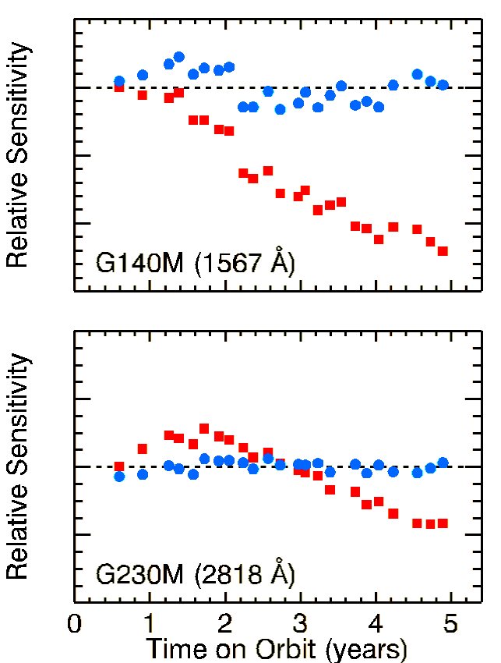
Good Graph
These are examples of good graphs, with nice line widths and good colors.
Do !

Slide 23






Charts and Graphs
80
70
60
50
Mode A
Mode B Mode C
40
30
20
10
0
North America
Europe
A ustrailia
Don’t

Slide 24



























Charts and Graphs
80
70
60
50
40
30
20
10
0
Mode A
Mode B
Mode C
North America
Europe
Australia
Do !

Slide 25
This is a good, readable table. Tables, especially large ones, should be placed on a separate slide.
4/19 Fri | 109 | NICMOS restarted, Ne-loop control continues
4/22 Mon | 112 | Change to mountingDcuop!control
4/23 Tue | 134 | Return to Ne control, Filter wheel test begins
4/24 Wed | 155 | Increase control temperature to allow for +2 K variations
4/25 Thur | 165 | Begin darks every 3rd orbit
4/26 Fri | 174 | DQE test visit 1; Control temp +0.5 K

Slide 26

Illustrations
Use only when needed, otherwise they become distracters instead of communicators
They should relate to the message and help make a point
Ask yourself if it makes the message clearer
Simple diagrams are great communicators
Do !

Slide 27
Don’t !

Slide 28
Limit Each Slide to One Idea
Use Bullet Points to Cover Components of Each Idea

Slide 29
Bullets
Keep each bullet to 1 line, 2 at the most
Limit the number of bullets in a screen to 6, 4 if there is a large title, logo, picture, etc.
  This is known as “cueing”
  You want to “cue” the audience on what you’re going to say
    Cues are a a brief “preview”
    Gives the audience a “framework” to build upon

Slide 30
Bullets (con.)
If you crowd too much text, the audience won’t read it
  Too much text looks busy and is hard to read
  Why read it, when you’re going to tell them what it says?
  Our reading speed does not match our listening speed; hence, they confuse instead of reinforce

Slide 31
Points to Remem^{D}bº e^{no}r^{t do this!}
Limit Bullet Points To a few words
Limit each slide to 1 idea
Limit each bullet point to only a few words to avoid long sentences that go on and on!
Limit animation – Too much animation can be distracting. Be consistent with animation and have all text and photos appear on the screen the same way each time. There are many animation modes to choose from, but it is best to use just one throughout.

Slide 32
Points to Remember
Keep bullet points brief
Use the same background for each slide
Use dark slides with light colored text in large hall events
Do !

Slide 33
Avoid the “All Word” Slide
Don’t
Another thing to avoid is the use of a large block paragraph to introduce your information. Attendees do not like to have what is on the screen, read to them verbatim. So, please use short, bulleted statements and avoid typing out your whole presentation on to the slides. Also, it is difficult for some to listen and read a large amount of text at the same time.

Slide 34

To make a slide stand out, change the font, background, or add animation.

Slide 35

Limit Animation !
Use the same animation throughout the entire presentation
Using more than one can be very distracting
– The audience will only see the animation and not the message you’re trying to get across
Bam!
Don’t

Slide 36

Limit Animation!
Use the same animation throughout the entire presentation
Using more than one can be very distracting
– The audience will only see the animation and not the message you’re trying to get across
Do !

Slide 37

YOU
Do not use the media to hide you
The audience came to SEE you
The media should ENHANCE the presentation, not BE the presentation
If you’re only going to read from the slides, then just send them the slides!
Remember, only you can prevent
“Death by PowerPoint”

