Slide 1
MusicXML
David Sears
MUMT 621
24 September, 2009

Slide 2
Outline
What is MusicXML?
The Other Guys
XML
Nuts & Bolts
Analytic Applications
Commercial Success
Notes:
What is MuseXML? A definition and why it’s necessary
The Other Guys? Commercial and Academic music representation formats
XML—the prerequisite language to MusicXML

Slide 3

What is MusicXML?
MusicXMl is a symbolic music format that is intended to support interchange between musical notation, performance, analysis, and retrieval applications (Good 2001b).
Most commercial music programs have their own internal, proprietary music representation and file format.
MusicXML attempts to do for sheet music and notation software what MIDI did for musical instruments (Good 2001a).
Notes:
It is designed to be a universal translator for programs that understand common western music notation.

Slide 4
The Other Guys: Commercial Formats
Standard Music Description Language (SMDL)
  First adopted in 1996, SMDL provides a tagging system for elements of musical notation, musical performance, and the “logical core of the work.”
  SMDL attempts to represent music too broadly.
Notation Interchange File Format (NIFF)
  Started in 1994, NIFF was designed to allow the interchange of music-notation data between music-notation editing and publishing programs.
  NIFF’s language environment was too foreign to other music applications, making it difficult for most developers to work with.
Music Instrument Digital Interface (MIDI)
  Possesses sophisticated representations for how to make music sound.
  Possesses primitive representations for how to represent a score.
Notes:
2 Commercial applications to a music interchange format
SMDL attempts to represent music too broadly, so potential users and tool-developers fail to see how SMDL might apply to their particular application.
MIDI: can’t show rests, enharmonic pitches.

Slide 5
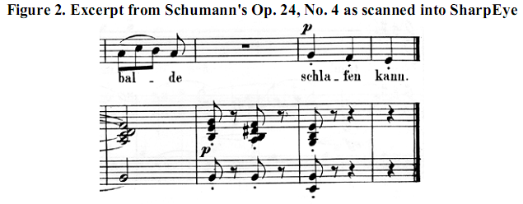
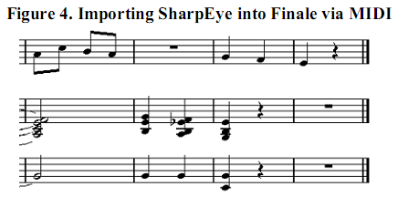
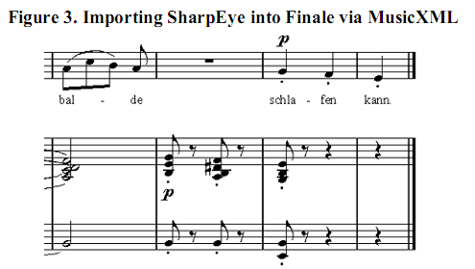
(Good, 2001b)

Slide 6
The Other Guys: Academic/Research Formats
Humdrum & MuseData
  Both formats have large music repertoires, and have been used for diverse music applications.
  The Humdrum toolkit requires UNIX familiarity, while MuseData requires TenX.
What Software Developers and Musicians Need:
  A design format complete enough for commercial and academic use, but usable enough to be approachable for developers.

Slide 7
Extensible markup language (XML)
  A ‘do it yourself’ markup language introduced in 1996.
  Has become a standard for data publishing and data exchange.
  Like HTML, it is a language based on tags, and can be written in the ASCII (text) format.
  Unlike HTML, users define their own tags in a separate file called a document-type definition (DTD).

Slide 8
Nuts & Bolts of MusicXML
  Designed by Michael Good in 2000.
  Represents common western musical notation from the 17th century onwards.
  2 basic categories of syntax information: elements and attributes.
<note name=“c” octave= “1”/>
  The Document Type Definition (DTD) deals with the expression of the semantics. It serves as a contract between the XML syntax and the reading software.
  Adapting this idea from Humdrum, MusicXML represents the score part-wise, meaning that measures are nested within parts in a hierarchy.
Notes:
Dumitrescu’s Corpus Mensurablis Musice Electronicum project is an example of an XML language that represents the mensural notation of European music in the 14th-16th centuries.

Slide 9
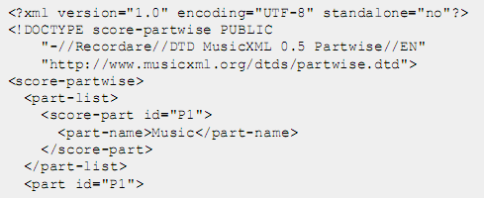
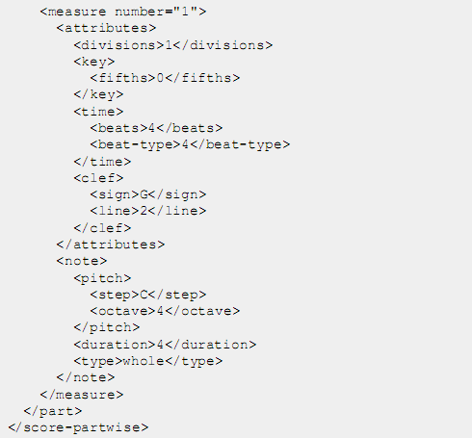

(Good, 2001b)
Notes:
Partwise=score contains parts, parts contain measures, measures contain notes

Slide 10
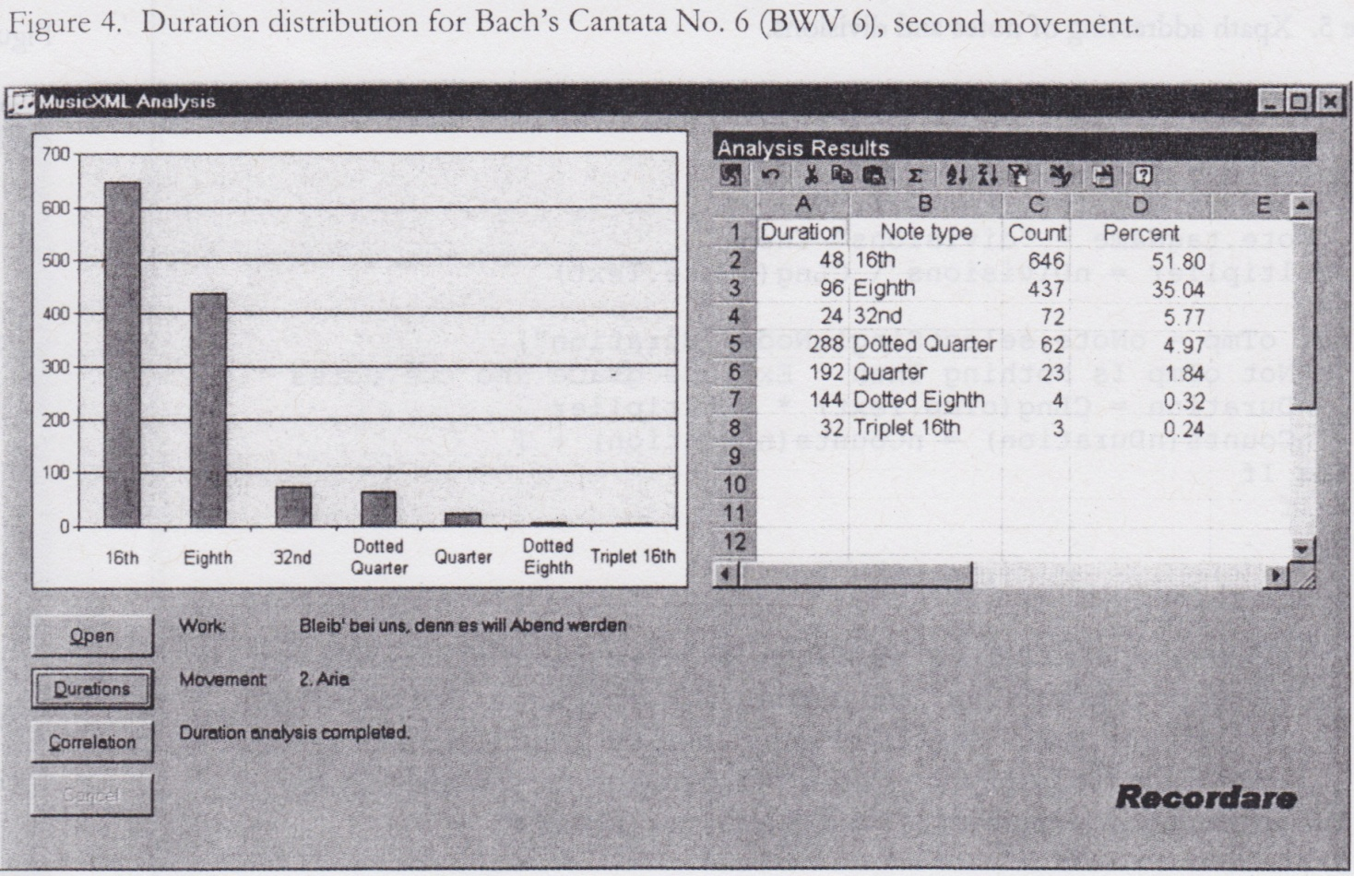
Analytic Applications
  Because XML formats are so generic, a huge set of software tools already exist to manipulate XML data (Ganseman et al, 2008).
  The Xquery engine can be used to retrieve statistical information from an XML database.
Notes:
Good’s main programming models: Document Object Model (DOM), and Simple API

Slide 11
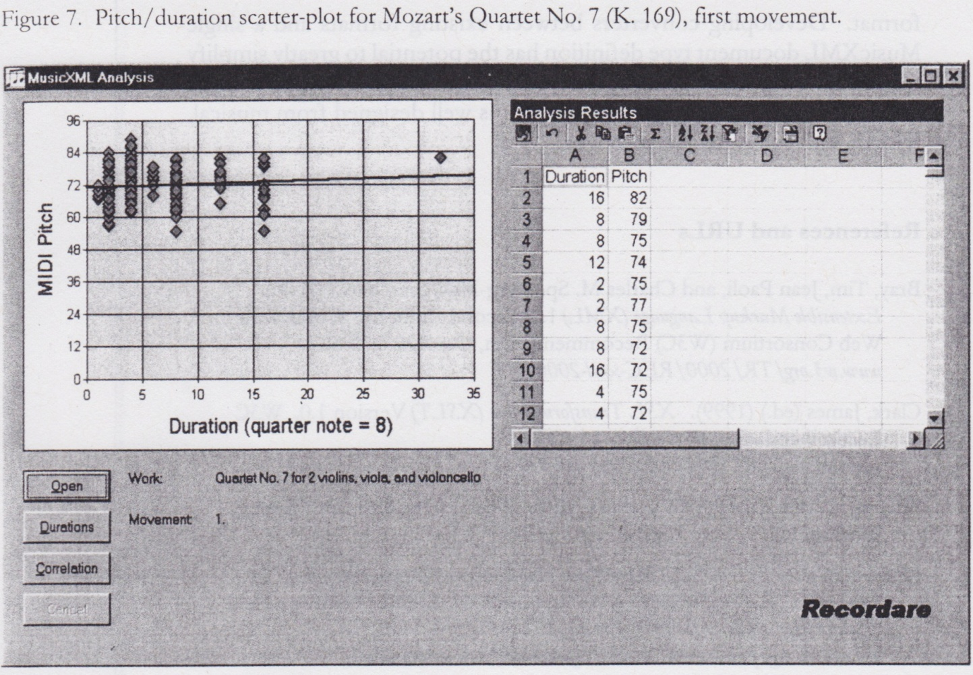

Slide 12
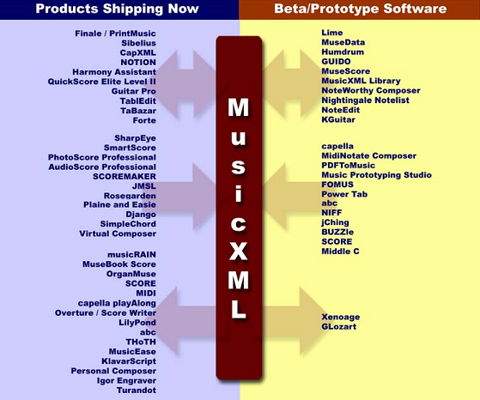
Commercial Success
  As of 2006, MusicXML works with over 60 music applications, including all market leaders for music notation editing and scanning.
Notes:
Usability Techniques
It made the software language musical, not computational (used Humdrum and MuseData’s language design), and chose names based on the application domain.
It used existing structures from leading applications.
It limited the scope that it would have to design for—western tonal music
It developed a format together with the software.
It supported a market leader early (attract a big fish).
It was the ideal time for MusicXML. XML provided a standard format for music representation across multiple platforms, something preexisting commercial interchange formats couldn’t provide, and something the academic formats didn’t want to provide.

