Slide 1
Gaussian Mixture Models
David Sears
Music Information Retrieval
October 8, 2009

Slide 2
Outline
Classifying (Musical) Data: The Audio Mess
Statistical Principles
Gaussian Mixture Models
Maximum Likelihood Estimation: EM Algorithm
Applications to Music
Conclusions

Slide 3
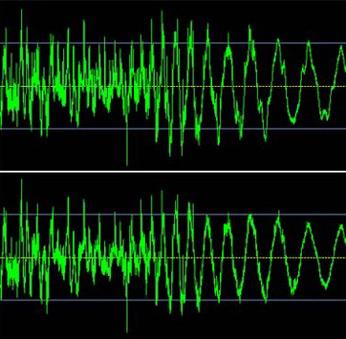

Classifying Data: The Audio Mess
Melody
Timbre

Slide 4
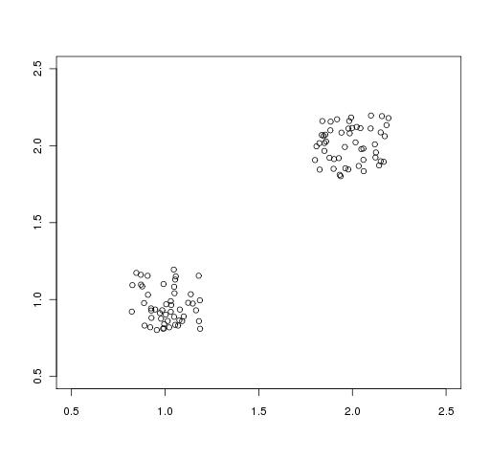
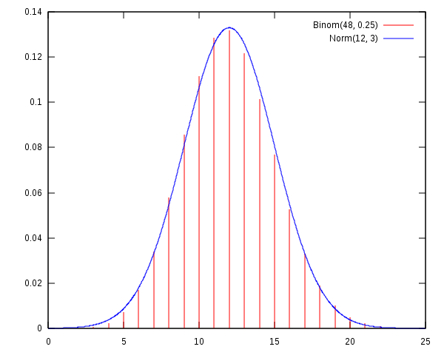
Statistical Principles
Gaussian (Normal) Distribution is a continuous probability distribution that describes data that cluster around a mean.
The probability density function provides a theoretical estimate of a sample of data.

Slide 5
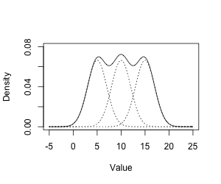
The Gaussian Mixture Model
A GMM can be understood simply as a number of Gaussians introduced into a population of data in order to classify each of the possible sample clusters, each of which could refer to our classes (timbre, melody, etc.).
The mixture densities must be decomposed.

Slide 6
Maximum Likelihood Estimation:
The Problem
How do you determine the weights of each of the Gaussian distributions?
Maximum likelihood (ML) estimation is a method for fitting a statistical model to the data. It roughly corresponds to least squares.
Standard Error = √∑(x-µ)²
ML estimates require a priori information about class weights, information that isn’t known in GMM.

Slide 7
Expectation-Maximization Algorithm
EM is an iterative procedure consisting of two processes:
  E-step: the missing data are estimated given the observed data and the current estimate of the model parameters
  M-step: The likelihood function is maximized under the assumption that the missing data are known (thanks to the E-step).
At each iteration the algorithm converges toward the ML estimate.
EM Example

Slide 8
Applications to MIR
Instrument Classification (Marques et al 1999)
Sound segments .2 seconds in length
3 features
  Linear prediction features
  Cepstral features
  Mel cepstral features
Results: The mel cepstral feature set gave the best results, with an overall error rate of 37%.

Slide 9
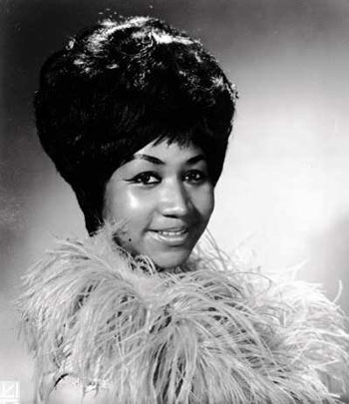
Applications to MIR
Melodic Lines (Marolt 2004)
Marolt employed a GMM to classify and extract melodic lines from an Aretha Franklin recording of “Respect” using only pitch information.
The EM algorithm honed in on the dominant pitch in the observed PDF.
For lead vocals, the GMM classified with an accuracy of .93.

Slide 10
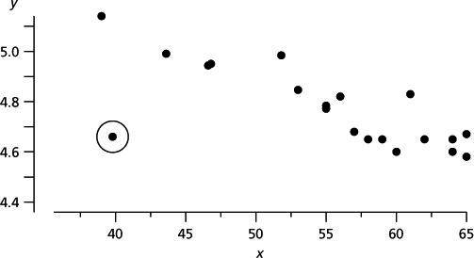
Conclusions
GMMs provide a common method for the classification of data.
The importance of choosing relevant features cannot be overestimated.
What do we do with outliers, i.e. nonparametric data?

