Slide 1

Symbolic Representations of Music
Ichiro Fujinaga
Music Technology Area, Schulich School of Music
McGill University
Notes:
Distributed Digital Music Archives and Libraries

Slide 2
Computer representation of music by application category
Score-based
  DARMS, CMN, Score, SMDL, NIFF, GUIDO, MEI
Analytical
  Humdrum / **kern
Gestural
  MIDI
Compositional
  Music N (Csound), Smoke, Nyquist, OpenMusic, Elody
Audio
  MP3, au, wav, sdii, ra, qt, snd
Descriptive
  MPEG 4, MPEG 7, MPEG 21

Slide 3
Score-based Formats
Binary formats
  Sibelius (Proprietary)
  Enigma (Finale - proprietary?)
  NIFF (Notation Interchange File Format)
  Score (Leland Smith)
ASCII / Unicode formats
  DARMS (1963)
  cmn
  GUIDO
  LilyPond (GNU project)
  Music Encoding Initiative (MEI)
  HTML / XML

Slide 4
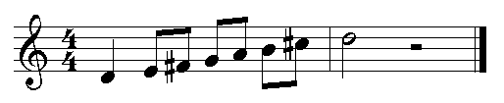
Examples
GUIDO
[\clef<"treble"> \meter<"4/4"> d/4 e/8 f# g a b c#2 d/2 _/2]
DARMS
!I1 !G !M4/4 0Q 1E 2# 3 4 5 6# 7H RH
cmn
(staff treble d4 q e4 e fs4 e a4 e b4 e cs5 d5 h half-rest)

Slide 5
HTML / XML
SMDL (Hytime, SGML)
MHTML
MusicML
MusiXML
MusicXML
MusiqueXML
Xmusic
Etc.

Slide 6
Example of MusicXML
<note>
  <pitch>
    <step>A</step>
    <octave>4</octave>
  </pitch>
  <type>half</type>
  <stem>up</stem>
  <notations>
    <slur type="start” number="1"/>
    <tied type="start"/>
  </notations>
</note>

Slide 7
MEI (Music Encoding Initiative)
<measure>
  <staff>
    <layer>
      <note pname="e" oct="4" dur="4"/>
      <beam>
        <note pname="c" oct="4" dur="8"/>
        <note pname="c" oct="4" dur="8"/>
      </beam>
      <rest dur="4"/>
      <rest dur="4"/>
    </layer
  </staff>
</measure>

Slide 8

Analytical (Humdrum /** kern)
Represents syntactic rather than orthographic (visual) information. Designed for analysis rather than printing.
!! Fux: "Gradus ad Parnassum”
**kern
*M4/4
*k[]
=1-
2d/
4f/
4a/
=2
2b-/
2a/
==|!
*-
Notes:
/ stemup
\ stemdown

Slide 9
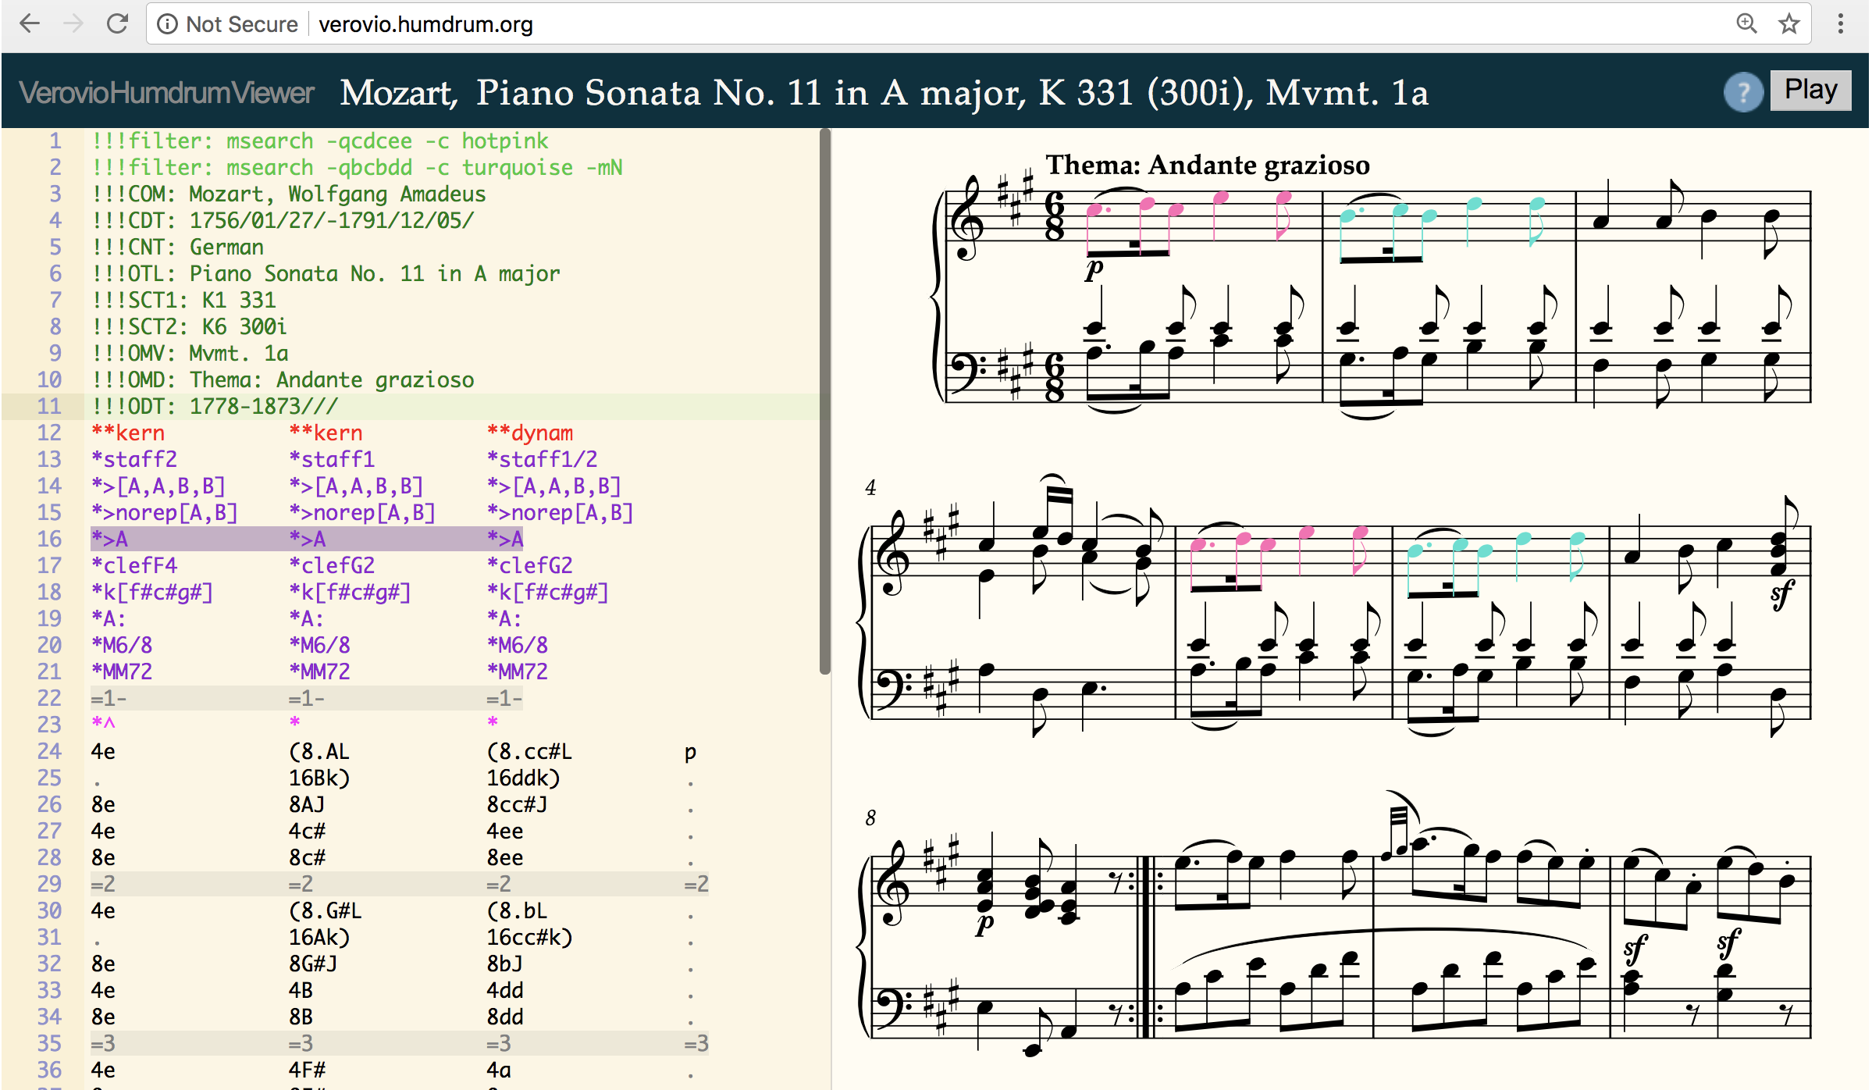
VerovioHumdrumViewer
Notes:
/ stemup
\ stemdown

Slide 10
Gesture / Performance
Piano roll
MIDI (SMF)
  Ubiquitous
  Keyboard -centric (note and velocity)
SKINI (Synthesis toolKit Instrument Network Interface)
Notes:
Musical Instrument Digital Interface

Slide 11
Compositional
Music N (Csound)
SmOKe (Smalltalk)
Nyquist (Lisp)
Max/MSP (visual object-oriented graphical programming environment)
Elody (java, MIDI, visual functional programming environment)
OpenMusic (visual Lisp-based programming environment)
SuperCollider, Kyma, etc.

Slide 12
Csound example
Orchestra file
Score file
instr 1
asig oscil 1000, cpspch(p5), 1
out asig
endin
f1 0 256 10 1 ; a sine wave table
; a pentatonic scale
; start dur amp pitch
i1 0 .5 0 8.01
i1 0.5 . . 8.03
i1 1.0 . . 8.06
i1 1.5 . . 8.08
i1 2.0 . . 8.10
e

Slide 13
SmOKe example
Smallmusic Object Kernel (Stephen T. Pope)
[(EventList newNamed: #test1)
add: (0 => (Event dur: 1/4 pitch: 'c3' ampl: 'mf');
add: (1 => ((Event new) dur: 6 ampl:0.3 sound: #s73bw))]
"C-minor fugue theme.”
((0.5 beat => ((1/4 beat), ('c3' pitch),
(voice: 'harpsichord'))),
((1/4 beat), ('b2' pitch)),
((1/2 beat), ('c3' pitch)),
((1/2 beat), ('g2' pitch)),
((1/2 beat), ('a-flat2' pitch)) )

Slide 14
Nyquist
(Roger Dannenberg)
Example I: Sequences
(defun note (pitch dur)
(osc pitch dur *table*))
(play (seq (note c4 i)
(note d4 i)
(note f4 i)
(note g4 i)
(note d4 q)))

Slide 15
Nyquist
Example II: Transformation
; env-note produces an enveloped note. The duration defaults to 1.0, but stretch can be used to change the duration.
(defun env-note (p)
(mult (note p 1.0)
(env 0.05 0.1 0.5 1.0 0.5 0.4)))
; now use stretch to play different durations
(play (seq (stretch 0.25(seq (env-note c4)(env-note d4)))
(stretch 0.5 (seq (env-note f4)(env-note g4)))
(env-note c4)))

Slide 16
Descriptive / compression
MPEG 4
  structured audio (SAOL)
MPEG 7
  a standard for describing features of multimedia content
MPEG 21
  an open framework for multimedia delivery and consumption

Slide 17
Music Representation by Humans
Symbolic?
Search
Recall

Slide 18

Music Representation by Humans
Symbolic?
Search
Recall
Identification
  Example 1
  Example 2
  Example 3
  Example 4
  Example 5
Notes:
Waldstein Op.56 C+
Pathetique Op. 13 C-

